Slide 1
Medicare Physician Fee Schedule Database
10/10/2024
Closed Captioning: Auto-generated closed captioning is enabled in this course and is at best 70-90% accurate. Words prone to error include specialized terminology, proper names and acronyms.
2033_1024

Slide 2
Today’s Presenters
Carleen Parker
Christine Obergfell
Provider Outreach and Education Consultant
Provider Outreach and Education Consultant

Slide 3
National Government Services, Inc. has produced this material as an informational reference for providers furnishing services in our contract jurisdiction. National Government Services employees, agents, and staff make no representation, warranty, or guarantee that this compilation of Medicare information is error-free and will bear no responsibility or liability for the results or consequences of the use of this material. Although every reasonable effort has been made to assure the accuracy of the information within these pages at the time of publication, the Medicare Program is constantly changing, and it is the responsibility of each provider to remain abreast of the Medicare Program requirements. Any regulations, policies and/or guidelines cited in this publication are subject to change without further notice. Current Medicare regulations can be found on the CMS website.
Disclaimer

Slide 4
Recording
Attendees/providers are never permitted to record (tape record or any other method) our educational events. This applies to webinars, teleconferences, live events and any other type of National Government Services educational events.
Objective
Assist providers in understanding the MPFSDB, how to access the database files and use the information found in the searchable database prior to submitting Medicare Part B claims.

Slide 5
Agenda
NGS Physician Fee Schedule Tool
Database Policy Indicators
NGS Lookup Tool Examples
CMS MPFSDB
CMS Lookup Tool Examples
Resources and References
Questions

Slide 6
NGS Physician Fee Schedule Lookup Tool

Slide 7
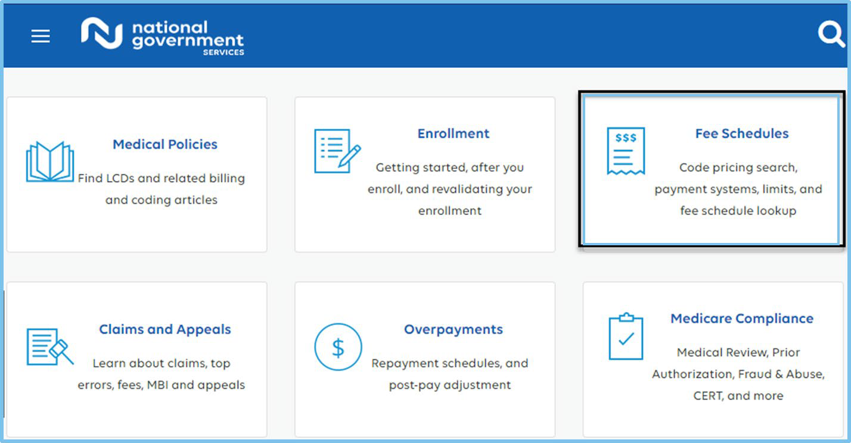
Medicare Physician Fee Schedule

Slide 8
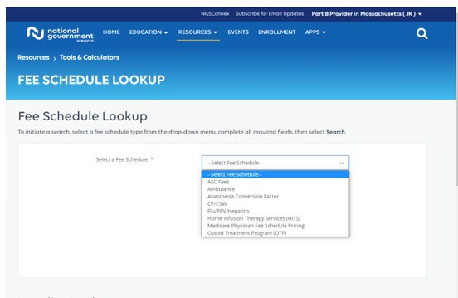
Fee Schedule Lookup – Types

Slide 9
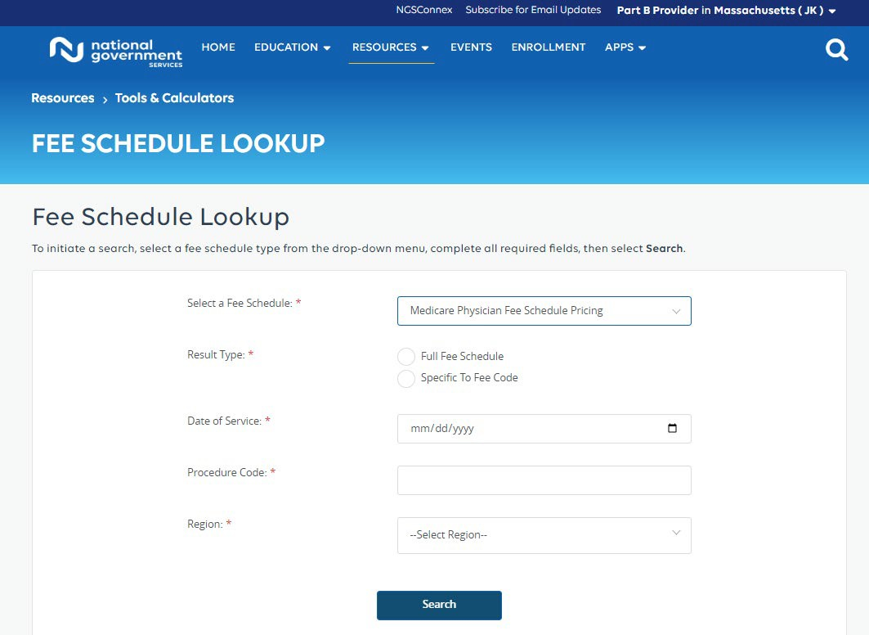
Fee Schedule Lookup

Slide 10
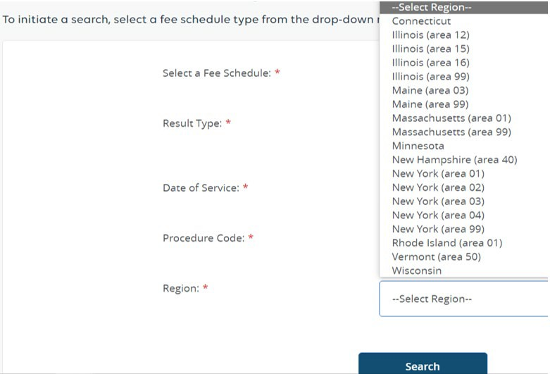
Fee Schedule Lookup – Regions

Slide 11
Illinois Locality/Area and County Information
Locality/Area | Counties
12 | Bond, Calhoun, Clinton, Jersey, Macoupin, Madison, Monroe, Montgomery, Randolph, St. Clair, Washington
15 | DuPage, Kane, Lake, Will
16 | Cook
99 | All Other Counties

Slide 12
Maine and Massachusetts, Locality/Area and County Information
Locality/Area | State | Counties
01 | MA | Middlesex, Norfolk and Suffolk
99 | MA | All Other Counties
03 | ME | York and Cumberland
99 | ME | All Other Counties

Slide 13
New York Locality/Area and County Information
Locality/Area | State
01 | Manhattan
02 | Bronx, Brooklyn, Nassau, Rockland, Staten Island, Suffolk, Westchester
03 | Columbia, Delaware, Dutchess, Greene, Orange, Putnam, Sullivan, Ulster
04 | Queens
99 | All Other Counties

Slide 14
Database Policy Indicators

Slide 15
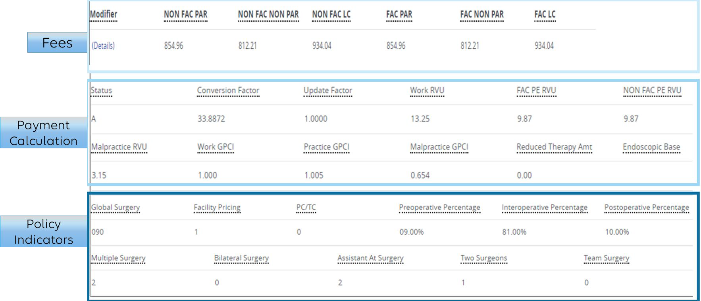
MPFSDB Policy Indicators

Slide 16
Policy Indicators
Procedure status indicators
Global surgery
Facility pricing
Preoperative
Interoperative
Postoperative
Multiple surgery
Bilateral surgery
Assistant at surgery
Two surgeons
Team surgery
Use References: Fee Schedule Lookup Details

Slide 17
Procedure Status Indicators
Field indicates whether the code is in the fee schedule and whether it is separately payable if the service is covered
Presence of an active (or valid) status code does not mean the service is covered by Medicare
Service may be valid according to the list but may not be considered covered due to other criteria such as medical necessity or global surgery rules

Slide 18
Procedure Status Policy Indicators
Policy Indicator | Description
A | Active code
B | Bundled code
C | Carriers price the code
E | Excluded from Physician Fee Schedule by regulation
I | Not valid for Medicare purposes
N | Noncovered Services: These services are not covered by Medicare
R | Restricted Coverage: Special coverage instructions apply

Slide 19
PC/TC Indicator
Indicator describes physician services that have global concept, professional or technical components
These include diagnostic and therapeutic radiology services, certain diagnostic tests that involve a physician’s interpretation and physician pathology services
Indicators identify TC for technical component and 26 professional component (PC)

Slide 20
PC/TC Policy Indicators
Policy Indicator | Description
0 | The concept of PC/TC does not apply since physician services cannot be split into professional and technical components
1 | These codes have both a professional and technical component. Modifiers 26 and TC can be used with these codes
2 | Professional Component Only Codes
3 | Technical Component Only Codes
4 | Global Test Only Codes

Slide 21
Global Surgery
Indicator provides the postoperative time frames that apply to payment for each surgical procedure or another indicator that describes the applicability of the global concept to the service
Global surgery, includes all the necessary services normally furnished by a surgeon before, during and after a procedure
Medicare payment for surgical procedure includes the preoperative, intra-operative, and postoperative services routinely performed by the surgeon or by members of the same group with the same specialty
Physicians in same group practice who are in the same specialty must bill and be paid as though they were a single physician

Slide 22
Global Surgery Policy Indicators
Policy Indicator | Description
000 | Endoscopic or minor procedure with related preoperative and postoperative relative values on the day of the procedure only included in the fee schedule payment amount; evaluation and management services on the day of the procedure generally not payable
010 | Minor procedure with preoperative relative values on the day of the procedure and postoperative relative values during a ten-day postoperative period included in the fee schedule amount; evaluation and management services on the day of the procedure and during the 10-day postoperative period generally not payable
090 | Major surgery with a one-day preoperative period and 90-day postoperative period included in the fee schedule payment amount

Slide 23
Multiple Procedure (Modifier 51)
Indicator for which payment adjustment rule for multiple surgical procedures applies
Multiple surgeries are separate procedures performed by single physician or physicians in same group practice on same patient at same operative session or on same day for which separate payment may be allowed and reduced
Providers do not use modifier 51

Slide 24
Multiple Procedure Policy Indicators
Policy Indicator | Description
0 | No payment adjustment rules for multiple procedures apply
1 | Standard payment adjustment rules in effect before 1/1/1996, for multiple procedures apply. 100 percent, 50 percent, 25 percent, 25 percent, 25 percent
2 | Standard payment adjustment rules for multiple procedures apply. 100 percent, 50 percent, 50 percent, 50 percent, 50 percent
3 | Special rules for multiple endoscopic procedures apply if procedure is billed with another endoscopy in the same family (that is, another endoscopy that has the same base procedure)

Slide 25
Bilateral Surgery (Modifier 50)
Indicates services subject to a payment adjustment
Bilateral services are procedures that can be performed on both sides of the body during same session or on same day by same physician or other qualified health care professional

Slide 26
Bilateral Surgery Policy Indicators
Policy Indicator | Description
0 | 150 percent payment adjustment for bilateral procedures does not apply
1 | 150 percent payment adjustment for bilateral procedure applies
2 | 150 percent payment adjustment for bilateral does not apply
3 | The usual payment adjustment for bilateral procedures does not apply

Slide 27
Assistant At Surgery (Modifiers 80/AS)
Indicates services where assistant at surgery may be paid
An assistant surgeon is defined as a physician who actively assists the operating surgeon
Assistant may be necessary because of the complex nature of procedure(s) or the patient’s condition
Assistant is usually trained in same specialty
Assistant at surgery may be physician assistant, nurse practitioner or nurse midwife acting under the direct supervision of a physician, where physician acts as surgeon and the assistant at surgery as an assistant
Assistant at surgery modifiers include
80 if the services are by a MD or DO
AS if by an NP, PA or CNS

Slide 28
Assistant at Surgery Policy Indicators
Policy Indicator | Description
0 | Payment restriction for assistants at surgery applies to this procedure unless supporting documentation is submitted to establish medical necessity
1 | Statutory payment restriction for assistants at surgery applies to this procedure. Assistant at surgery may not be paid
2 | Payment restriction for assistants at surgery does not apply to this procedure. Assistant at surgery may be paid
9 | Concept does not apply

Slide 29
Co-surgeons (Modifier 62)
Indicator for services that two surgeons, each in different specialty
Co-surgeons are defined as two or more surgeons, where the skills of both surgeons are necessary to perform distinct parts of a specific operative procedure
Co-surgery is always performed during the same operative session

Slide 30
Co-surgeon Policy Indicators
Policy Indicator | Description
0 | Co-surgeons not permitted for this procedure
1 | Co-surgeons could be paid, though supporting documentation is required to establish the medical necessity of two surgeons for the procedure
2 | Co-surgeons permitted and no documentation required if the two-specialty requirement is met
9 | Concept does not apply

Slide 31
Team Surgery (Modifier 66)
Indicator for services for which team surgeons may be paid
Under some circumstances, highly complex procedures may require the services of a surgical team, consisting of several physicians, often of different specialties, plus other highly skilled, specially trained personnel and complex equipment
Benefits are allowed for medically necessary procedures and allowance(s) will be determined on an individual consideration basis

Slide 32
Team Surgery Policy Indicators
Policy Indicator | Description
0 | Team surgeons not permitted for this procedure
1 | Team surgeons could be paid, though supporting documentation required to establish medical necessity of a team; pay by report
2 | Team surgeons permitted; pay by report
9 | Concept does not apply

Slide 33
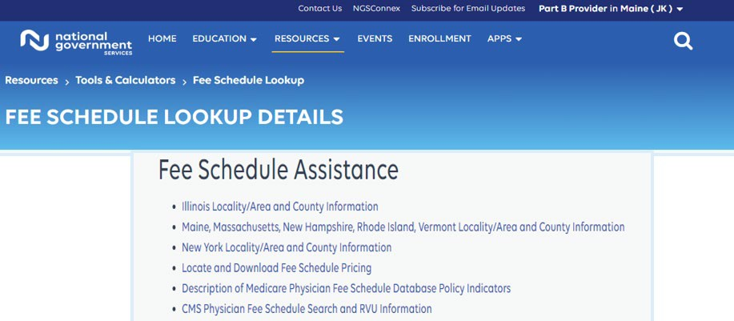
Fee Schedule Assistance
The fee schedule assistance page provides access to information about fee schedule definitions and acronyms

Slide 34
NGS Look-up Tool Examples

Slide 35
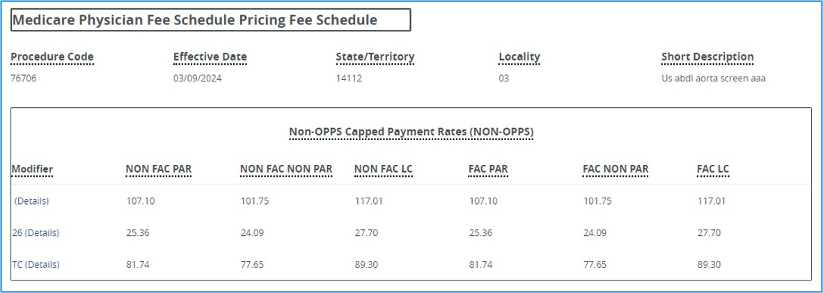
NGS Medicare Physician Fee Schedule Pricing and Database

Slide 36
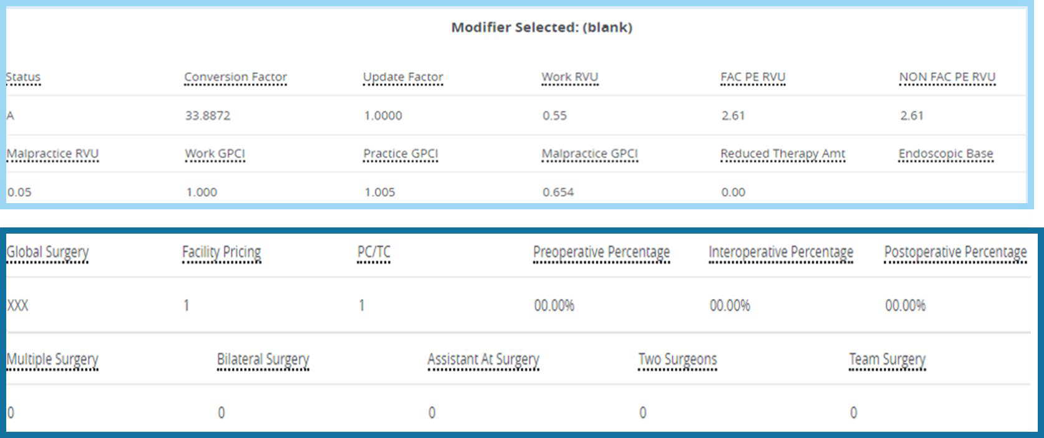
MPFSDB 76706

Slide 37
47480

Slide 38
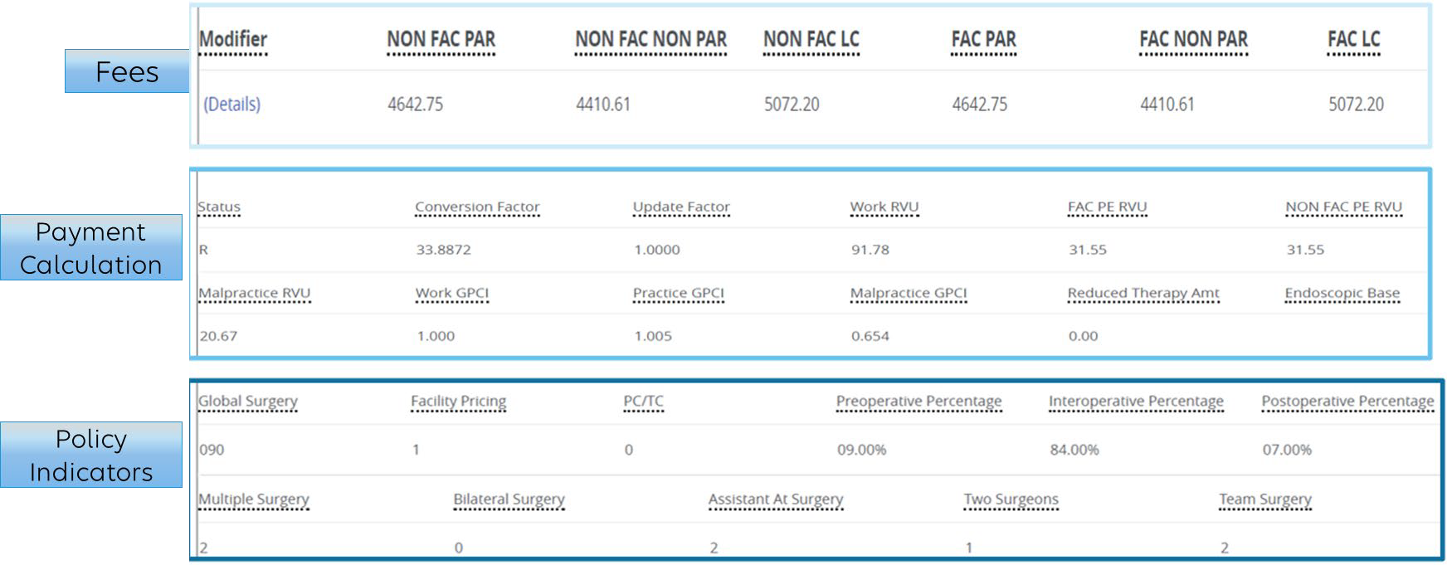
MPFSDB 33935

Slide 39
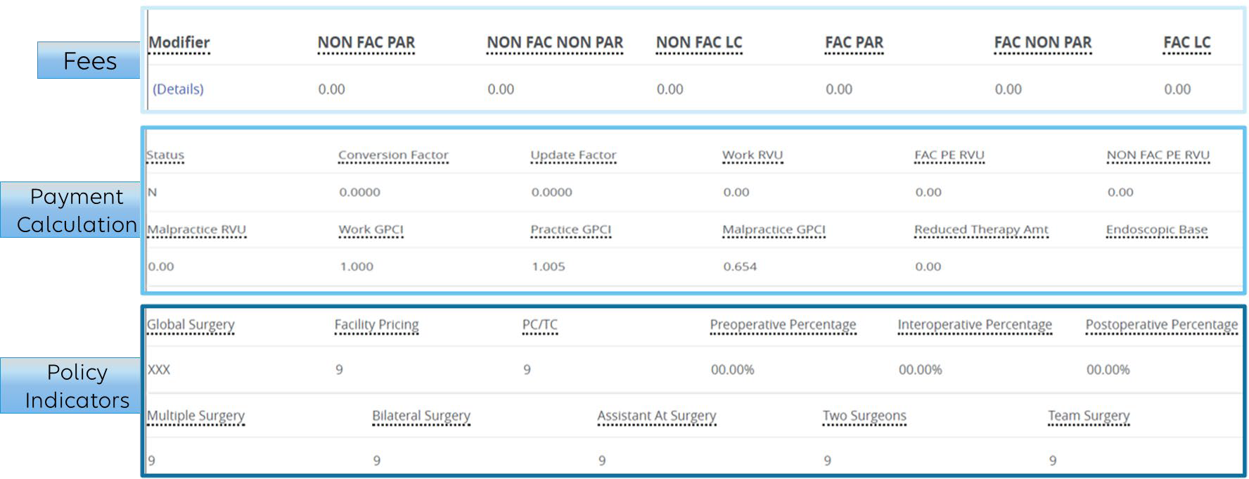
MPFSDB 99397

Slide 40
CMS MPFSDB

Slide 41
MPFSDB
How to Locate the Searchable Database
Located on CMS.gov official website
Overview of the Physician Fee Schedule Search
Why Use the Searchable Database?
Find Medicare payment amounts
Learn if codes to be billed are affected by payment policies
41

Slide 42
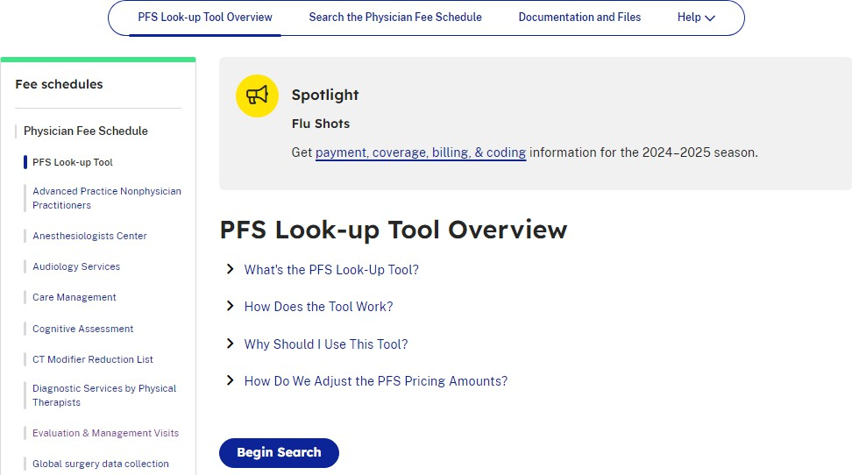
Searching the Database
PFS Look-Up Tool Overview
Pricing amounts
Payment policy indicators
RVUs
GPCIs

Slide 43
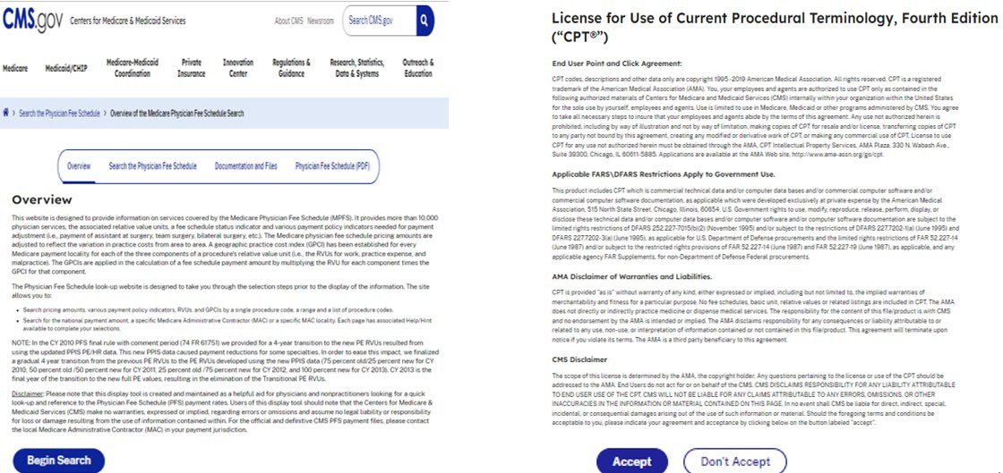
Begin Search

Slide 44
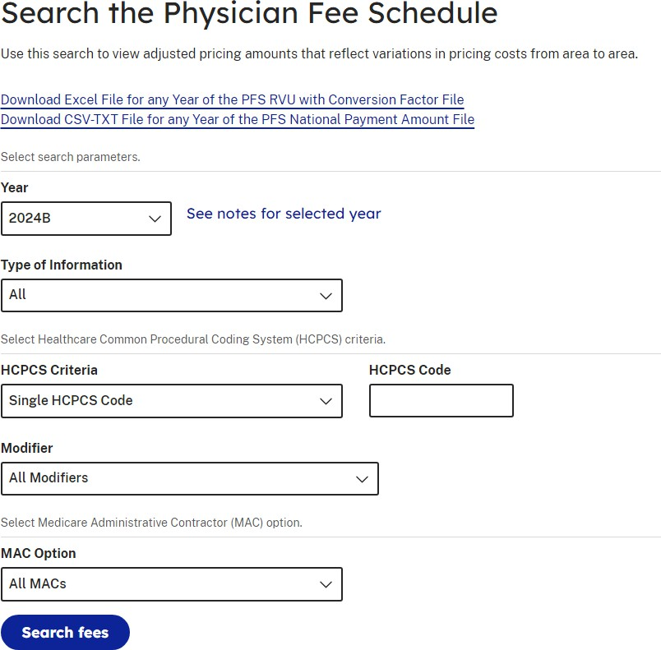
Search Criteria
44

Slide 45
CMS Lookup Tool Examples

Slide 46
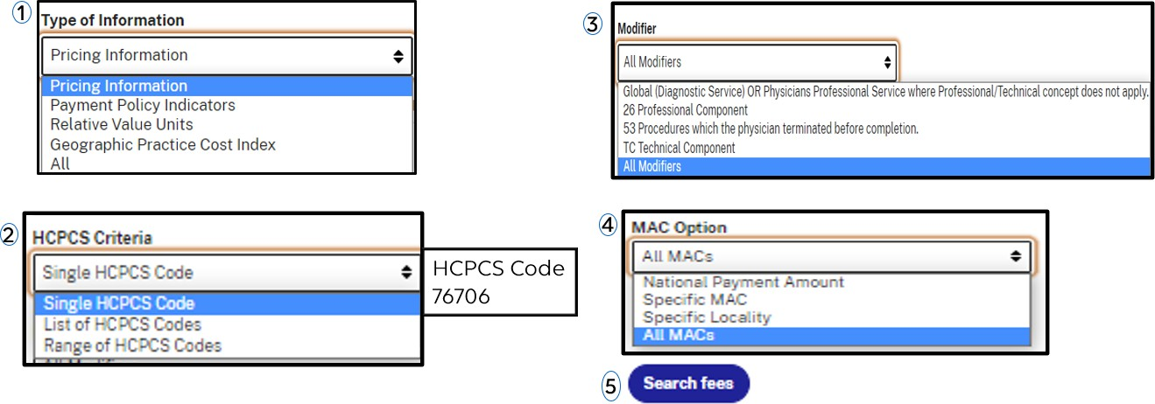
Search the Physician Fee Schedule

Slide 47
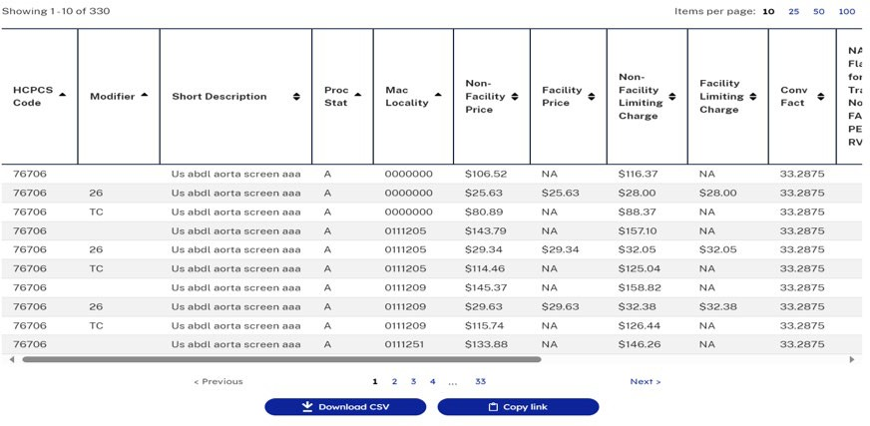
Search Results

Slide 48
Searching Payment Policy Indicators
Professional/technical modifiers
Postoperative days
If a code is payable by Medicare
Level of physician supervision required
If a service can be billed bilaterally

Slide 49
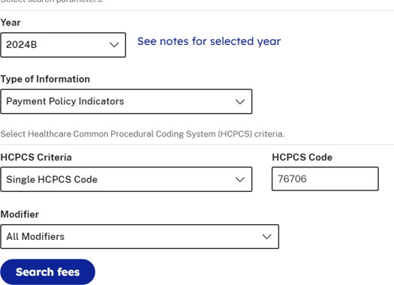
Payment Policy Indicators
49

Slide 50
76706 Search Results

Slide 51
47480 Search Results

Slide 52
33935 Search Results

Slide 53
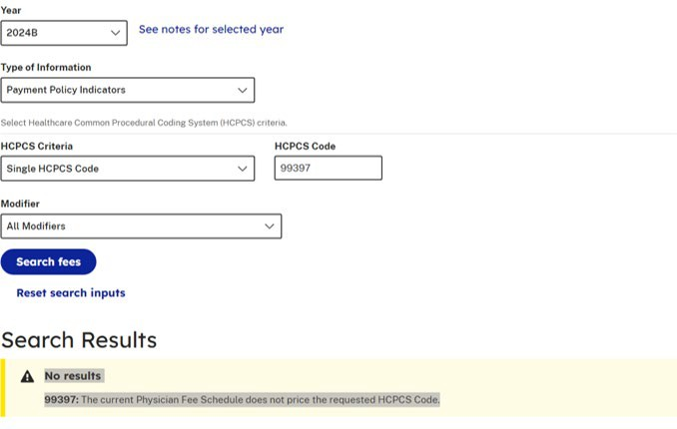
99397 Search Results

Slide 54
Resources and References

Slide 55
CMS and NGS Resources and References
CMS References
CMS website
Physician Fee Schedule Look-Up
NGS References
Fee Schedule Assistance
Locality and County Information for IL-ME-MA-NY
Description of Medicare Physician Fee Schedule Database Policy Indicators
55

Slide 56
Questions?
Thank you!

Slide 57
Connect with us on social media
YouTube Channel
Educational Videos
Medicare University
Self-paced online learning
LinkedIn
Educational Content

Slide 58
Find us online
www.NGSMedicare.com
Online resources, event calendar, LCD/NCD, and tools
NGSConnex
Web portal for claim information
IVR System
The interactive voice response system (IVR) is available 24-hours a day, seven days a week to answer general inquiries
Sign up for Email Updates
Subscribe for Email updates at the top of any NGSMedicare.com webpage to stay informed of news

